Slide 1
Analysis of Sales Data

Slide 2
Data Introduction
Data is given in a .csv file which is read into a dataframe for easier manipulation.
At a glance it can be seen that there is information about Product Type A and Type B.
Data contains both Numerical and Written(String) based information.
Understanding the data statistically and visually with the help of Python is the aim of this presentation.

Slide 3
Data Manipulation
Correcting some entries in the ‘year’ column using the year from the ‘date’ column.
This step would help the accuracy of the analysis due to the correctness of the information.
Thus concrete conclusions can be made using the analysis.

Slide 4
Statistical Information
Numerical data have many attributes that can be observed which can provide great insights.
Information such as quartiles can be used to plot a boxplot for a particular column.
Though we cannot observe everything while looking at String data but things like number of occurrences can help with comparing and contrasting.

Slide 5
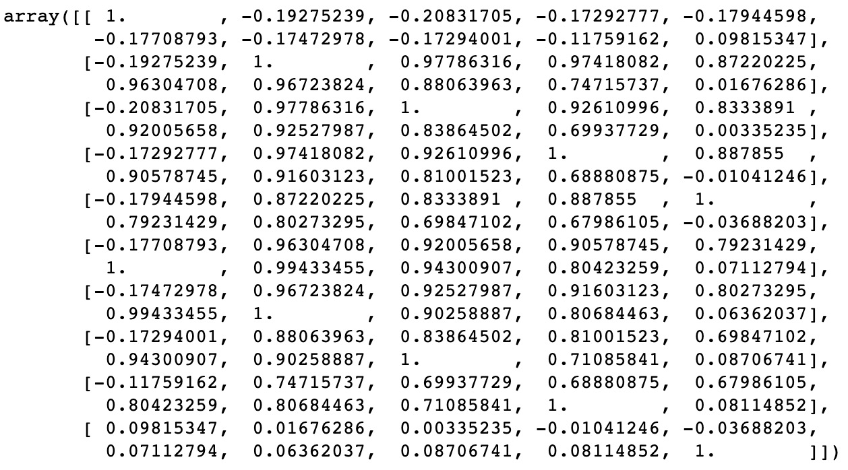
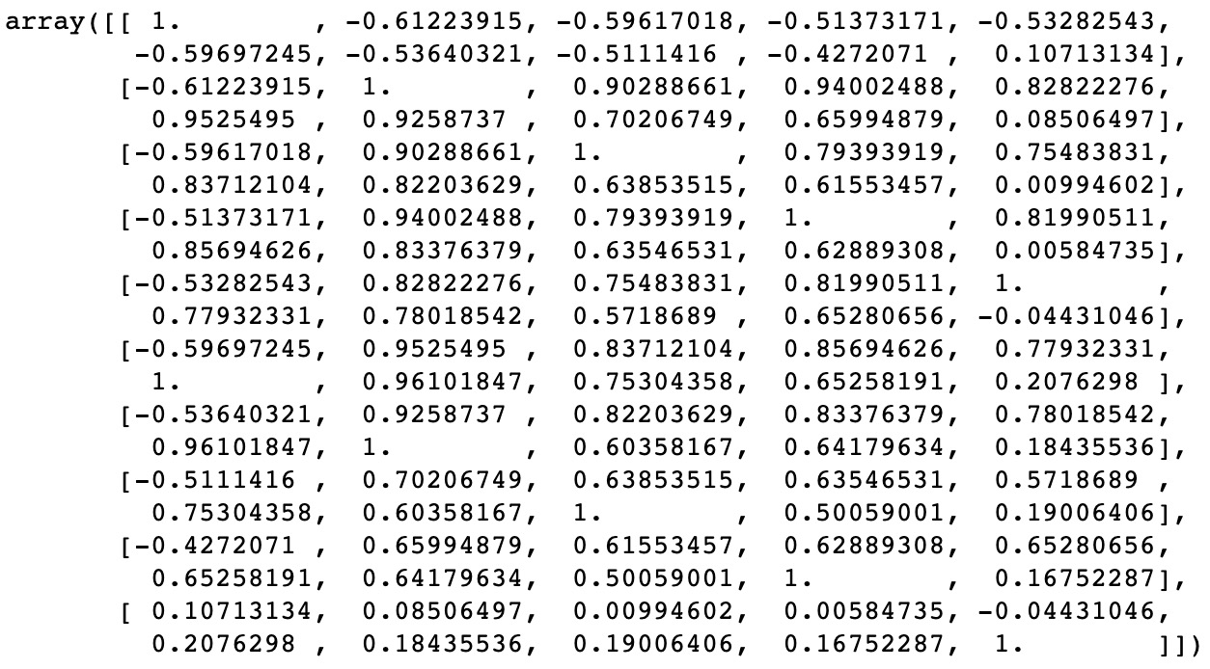
Data Correlation
Pearson
Spearman
Each feature will have maximum correlation(1) with itself.

Slide 6
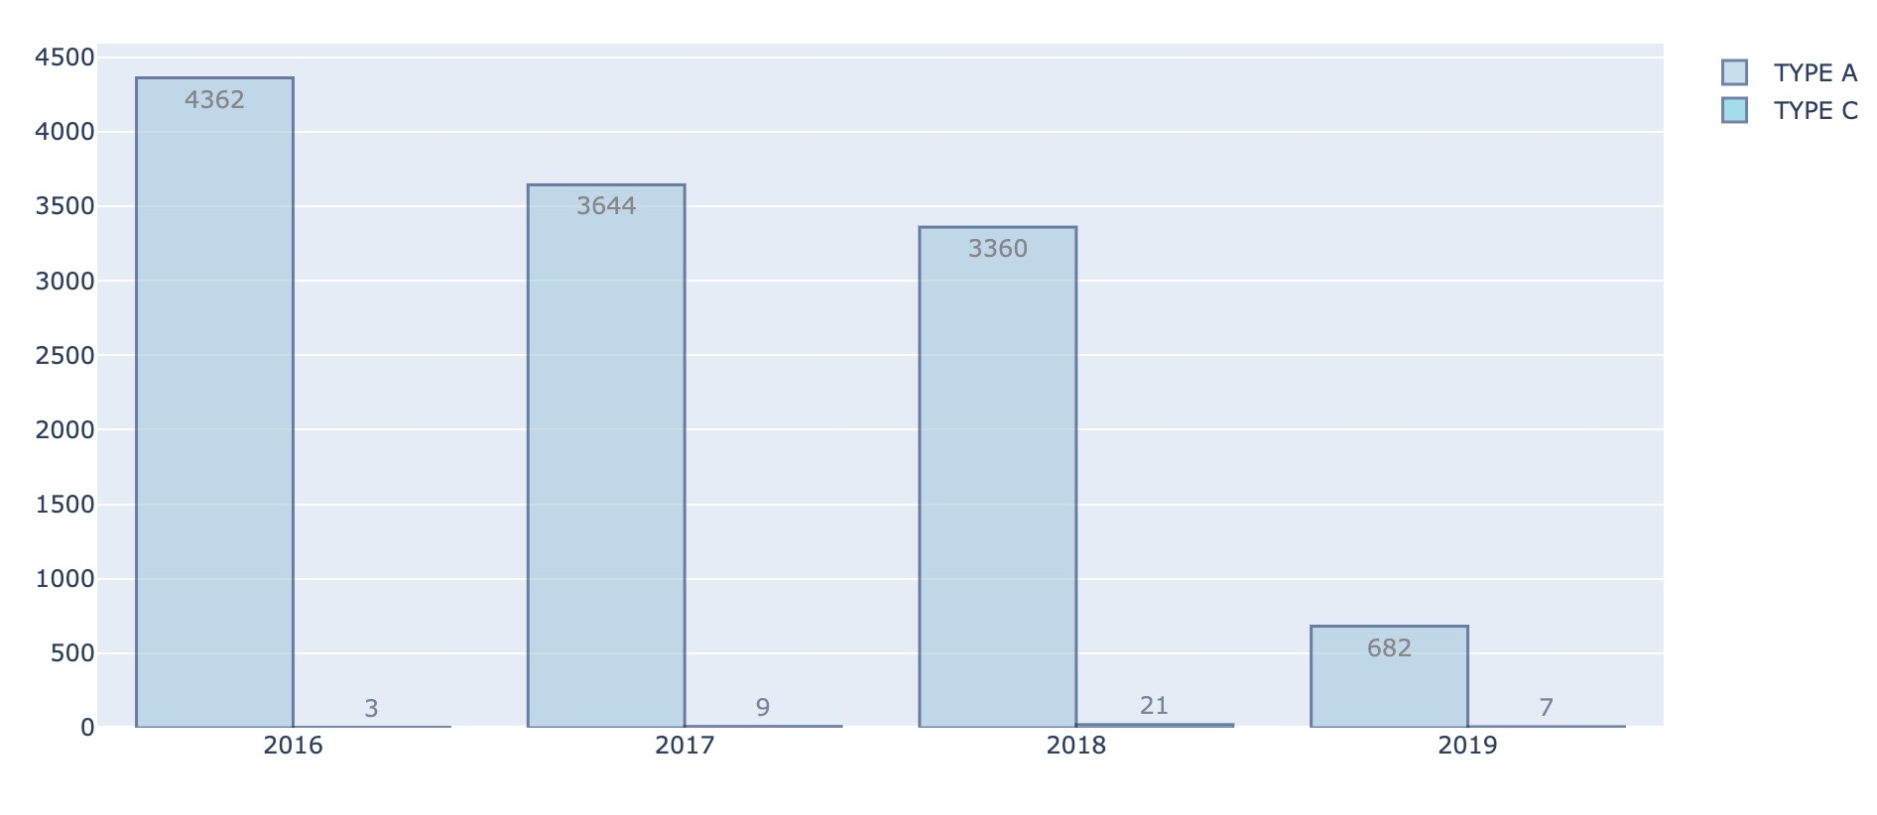
Product Sale Comparison
The graph below shows the comparison of the 2 different product types through
the years 2016-2019 with the column bags_lx on the y-axis to show comparison with
respect to a sales attribute.
We can see that Type A decreases through the years while Type C increases except 2019.

Slide 7
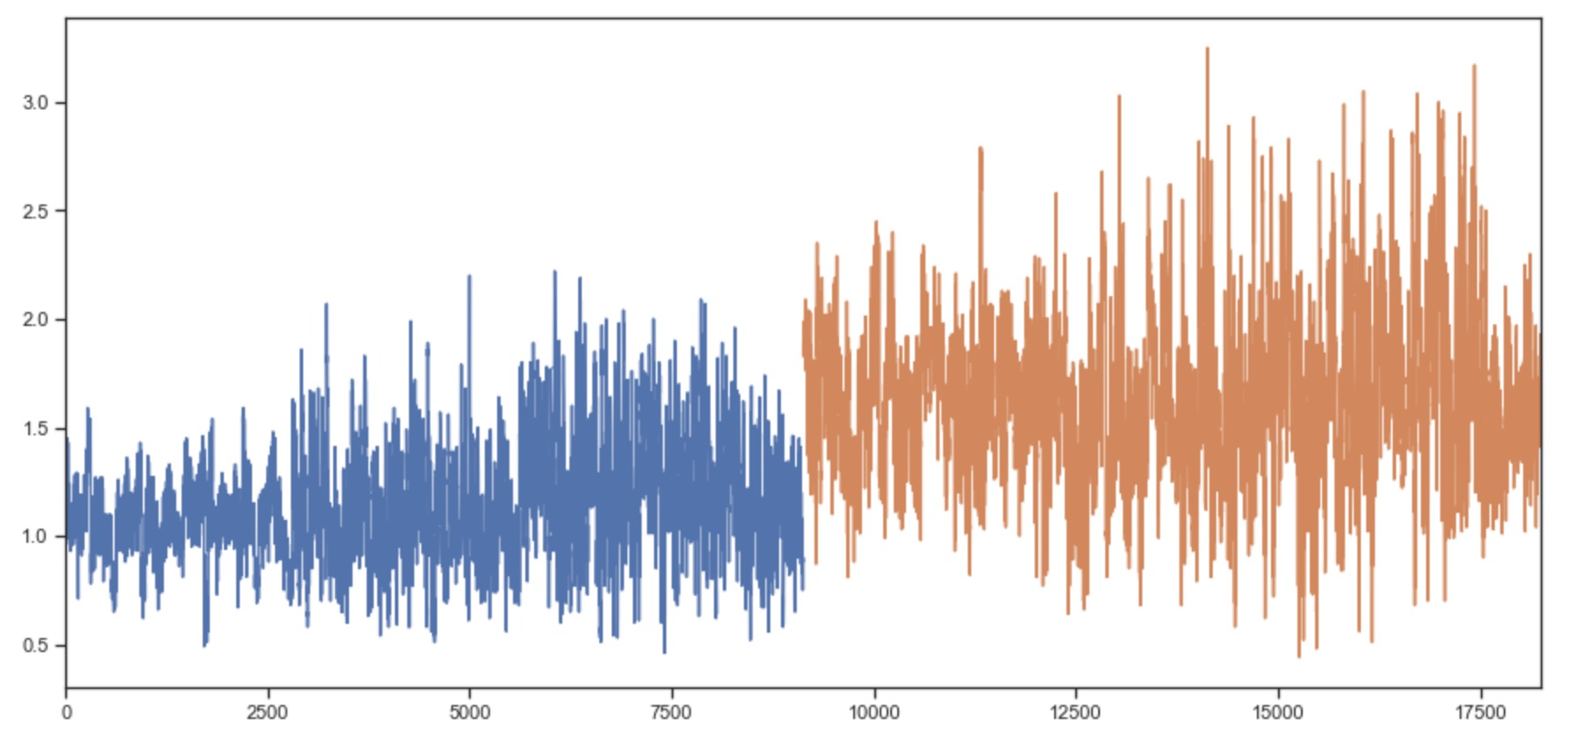
Price Comparison
The graph below shows the comparison between the prices of both the product
Types A and C, with the prices of Type A being higher than C.

Slide 8
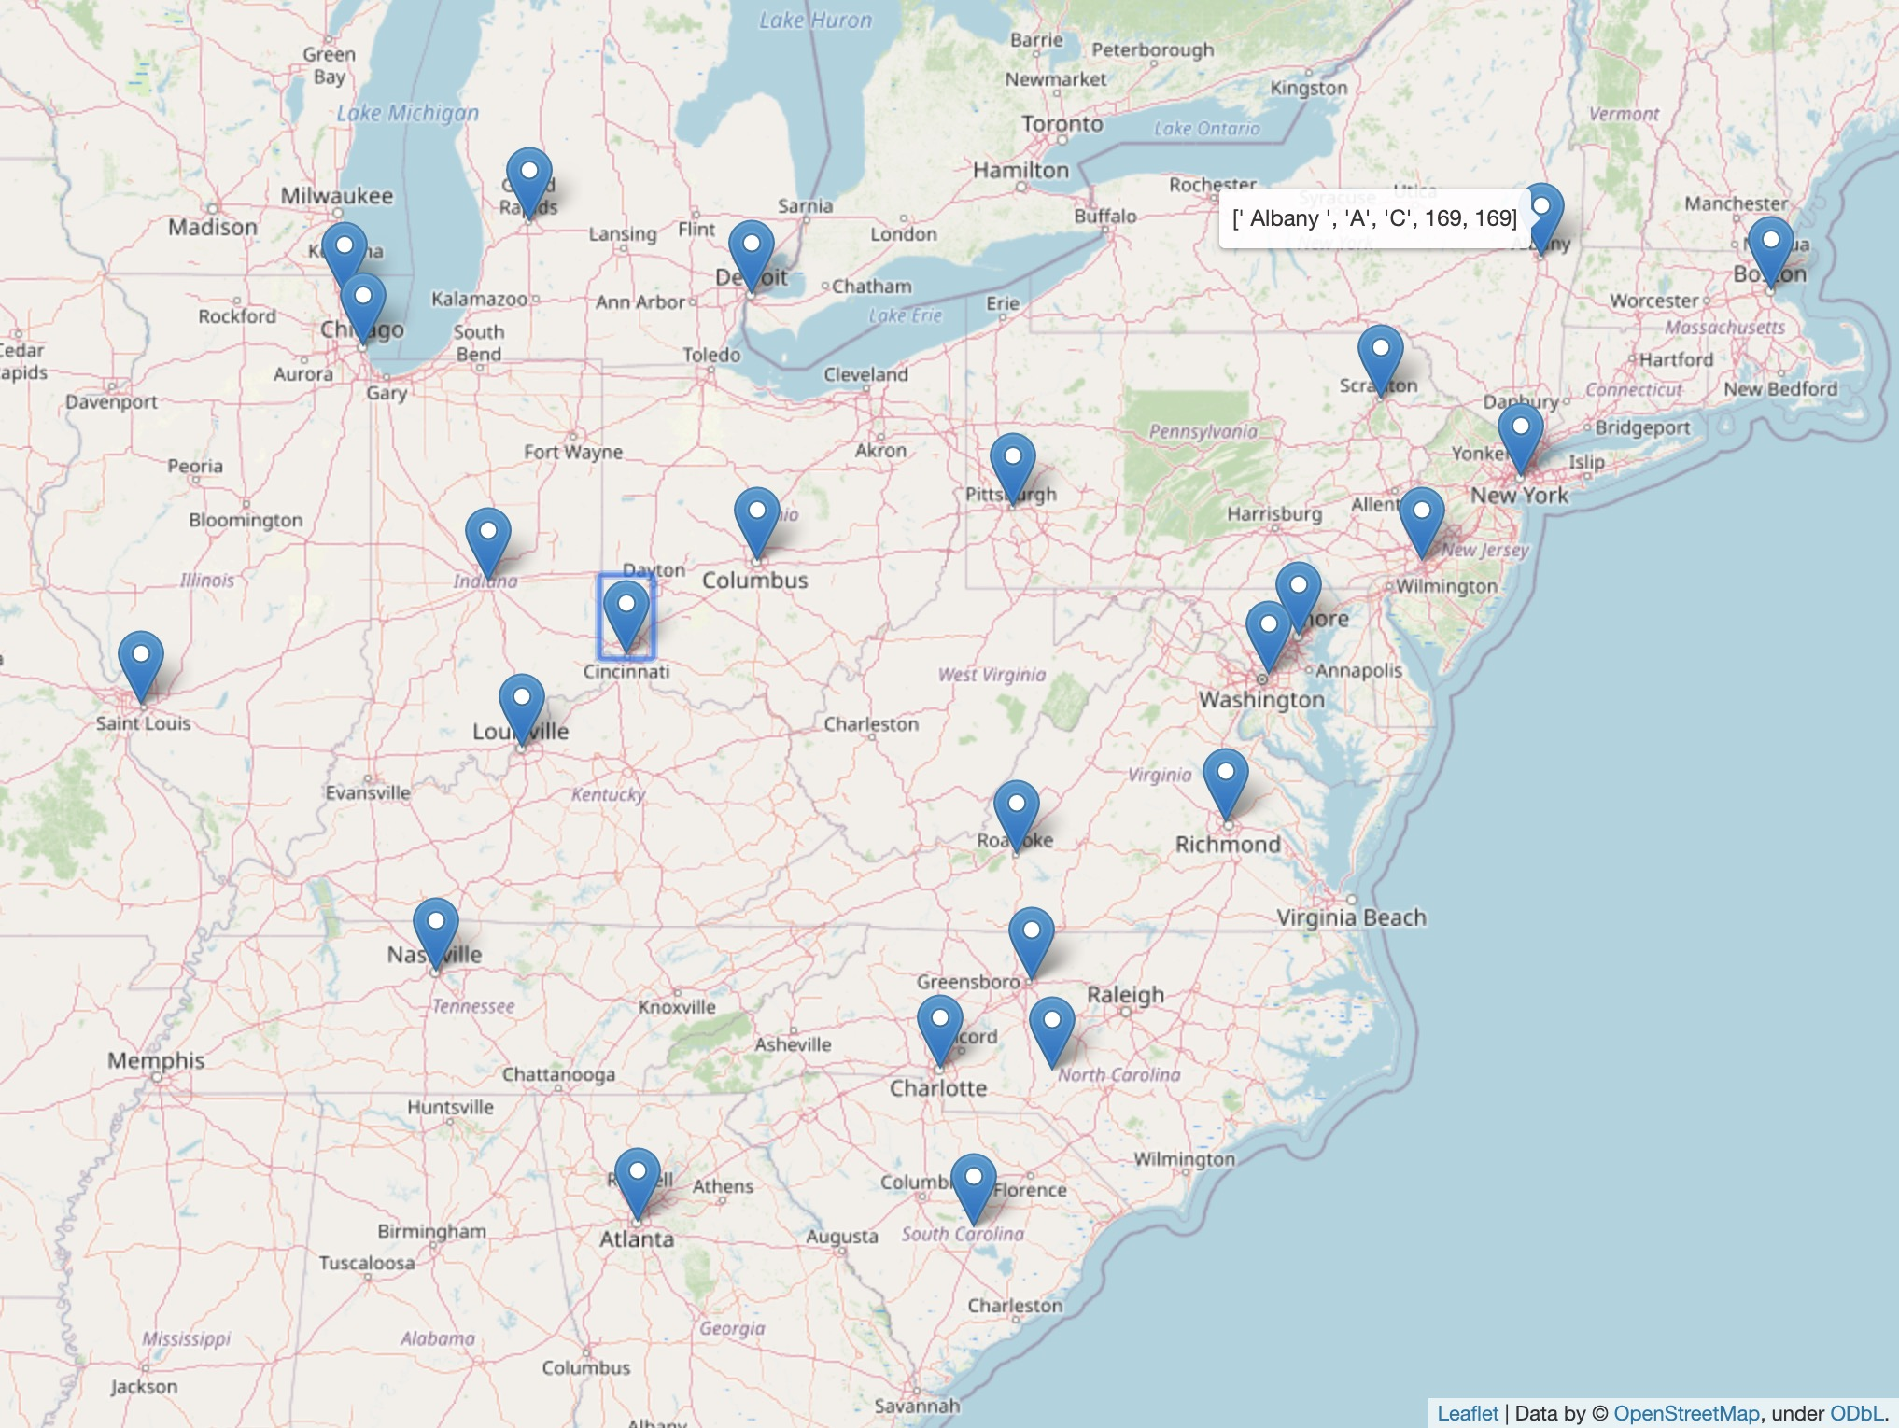
Interactive Data
The details of the data is represented with
respect to the location, adding a marker at
each location of a sale.
Hovering over a marker shows the count of
each product type A and C, and clicking a
marker displays the average values of other
attributes such as price, volume, etc.

Slide 9
Thank You

